Slide 1
Data Engineering
Assignment 1
Question 1
Ahmad Murad

Slide 2
Setting up the container
Create a folder on the C: drive and call it data
Copy the flow.xml.gz on c:/data
Copy the data.csv on c:/data
Then you need to pull the container using the below command:
docker pull apache/nifi
Then run the below command to start the container on port 8080 and with the data folder mounted to the logs folder in the container :
docker run --name nifi2 -p 8080:8080 -d -v c:\data:/opt/nifi/nifi-current/logs apache/nifi:latest

Slide 3
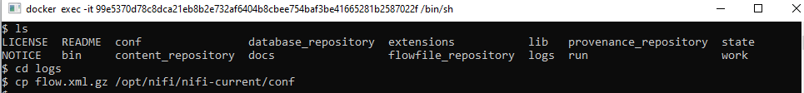
Once the docker is up select the CLI interface perform :
ls
cd logs
cp flow.xml.gz /opt/nifi/nifi-current/conf
Restart the container

Slide 4
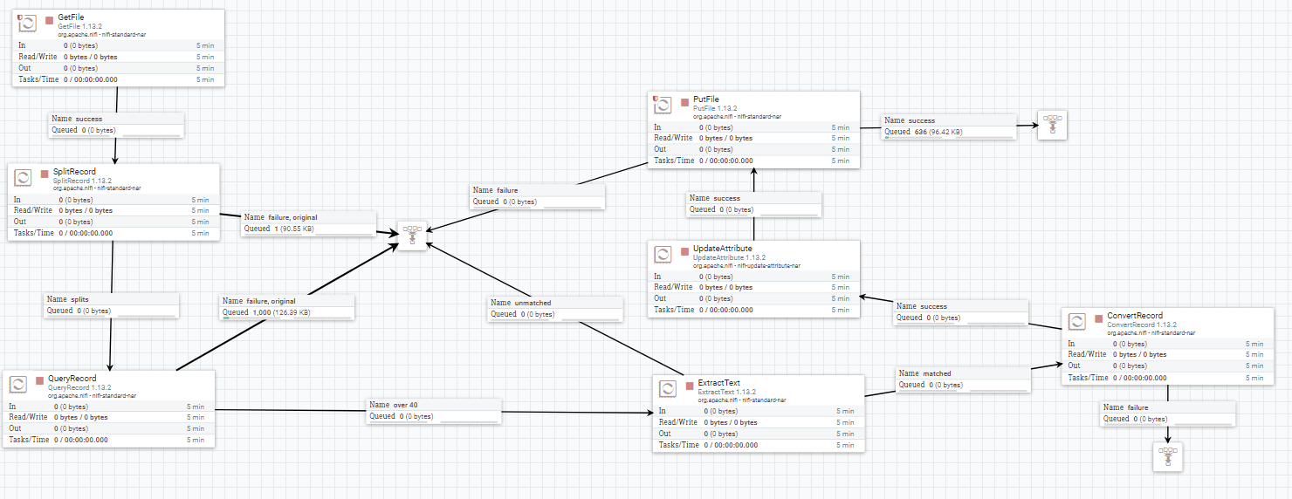
Accessing the Nifi flow
Once you access the container by http://localhost:8080/nifi
You will get the below flow

Slide 5
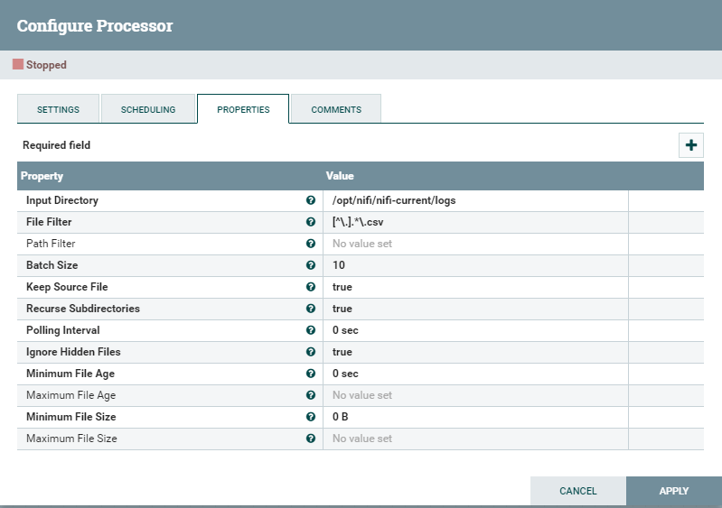
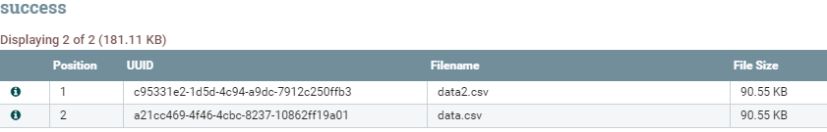
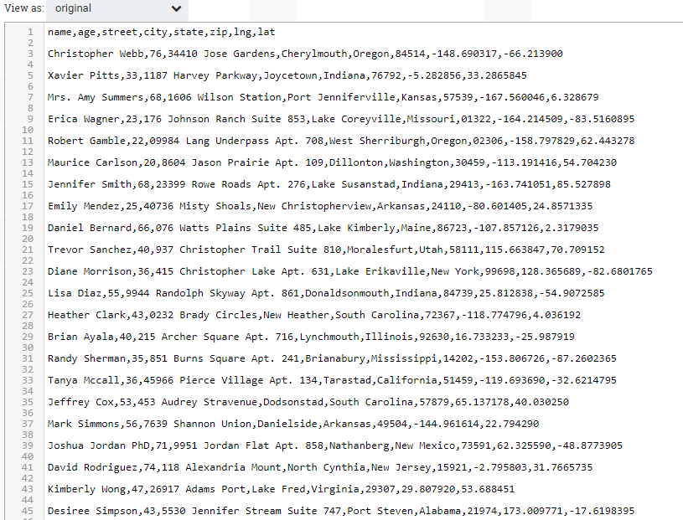
Getfile Processor
The Getfile processor will read the file from the specified location.
In this example it reading from directory /opt/nifi/nifi-current/logs which is already mapped to c:/data
And it will read only the .csv files with the file filter setup as [^\.].*\.csv

Slide 6
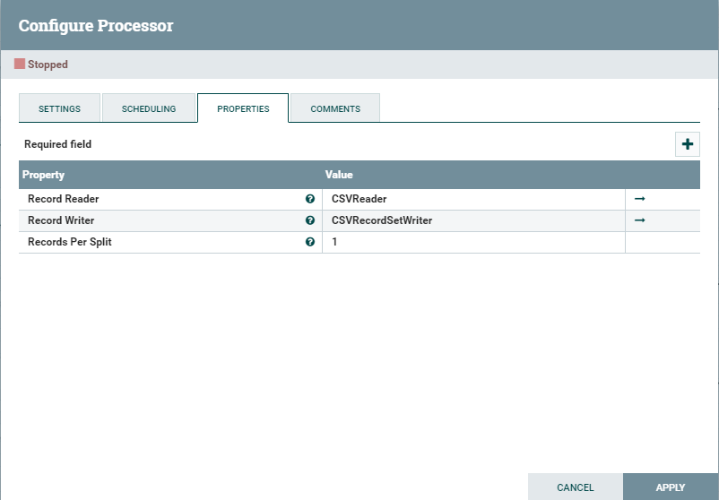
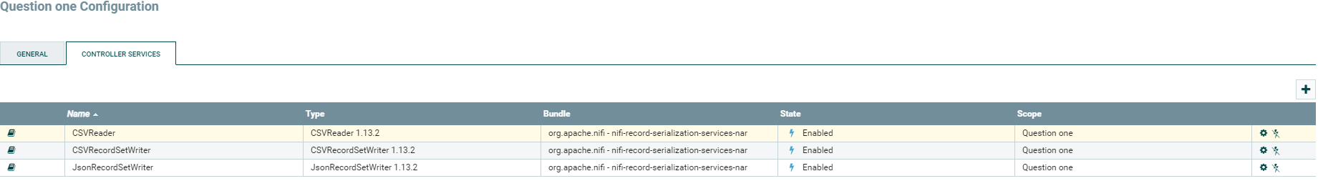
Splitrecords
This Processoer will read the CSV files and split the files into flowfiles , each has one record of the CSV file.
It will have to reading services , CSVReader and CSVRecordSetWriter. Which both needs to be enabled.

Slide 7
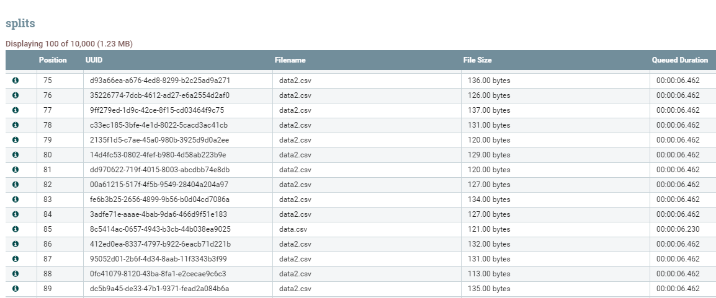
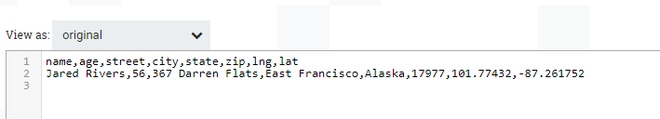
Splitrecords (cont.)
The output of the process will be multiple flowfiles each containing one record of the CSV file as shown below

Slide 8
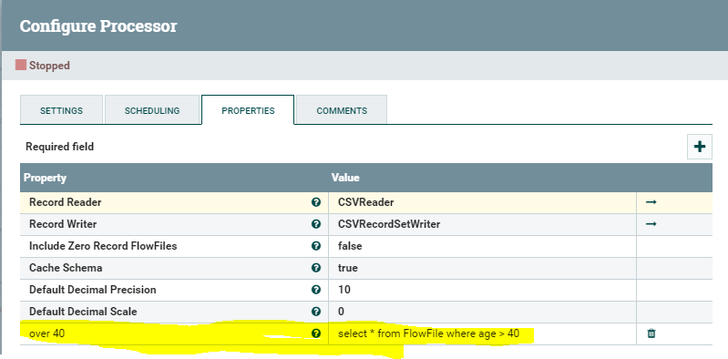


QueryRecord
This processor will filter the records based specific query to select flowfiles that are matching the query :
Select * from FlowFile where age > 40
The resulting flowfiles will be all having the ones with age field greater than 40
This property has been added manual

Slide 9
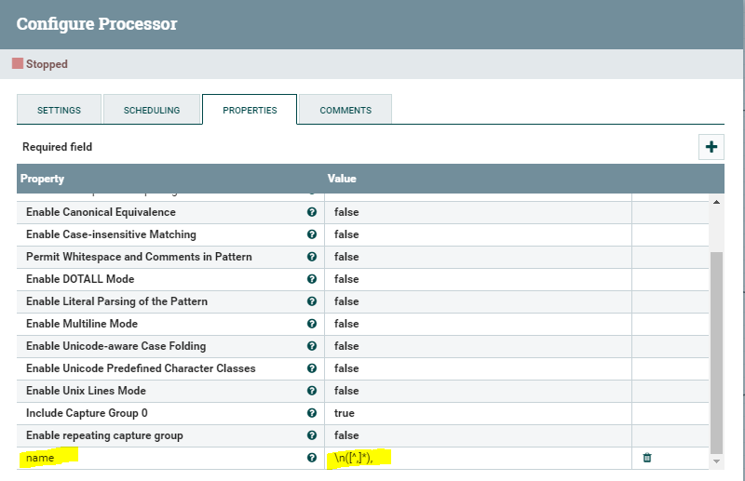
ExtractText
This processor will extract the name field from the FlowFile and tag it in name property .
This property has been added manual

Slide 10
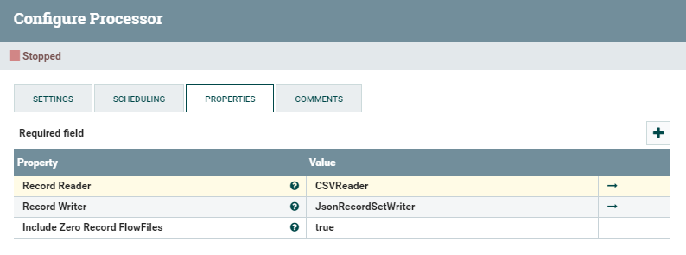
ConvertRecord
This processor will convert the record from one format to another
In our case it will convert the FlowFiles from csv to Json
We need to configure two services , CSVReader to read the FlowFile CSV , and JsonRecordSetWriter to write the reords in Json format
The result will be FlowFiles in Json Format as shown below with the same file name so far.

Slide 11
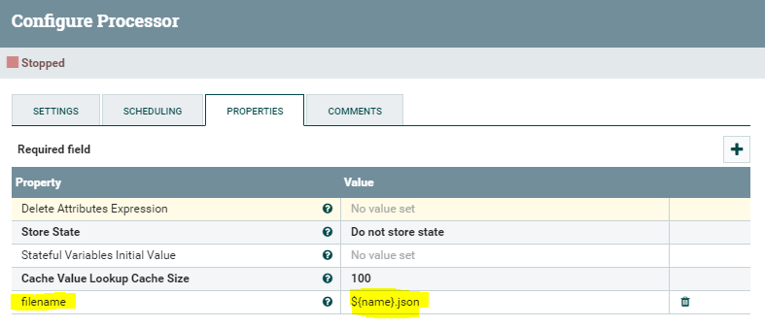
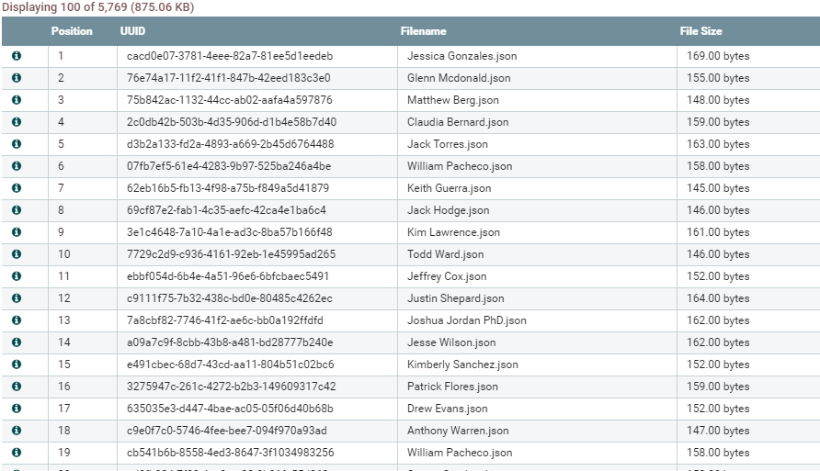
UpdateAttribute
This processor will add a new property entry to update the filename tag to be linked with the new file name regex ${name}.json which simply will take the name property that has been defined before and use it as file name , with .json extension.

Slide 12
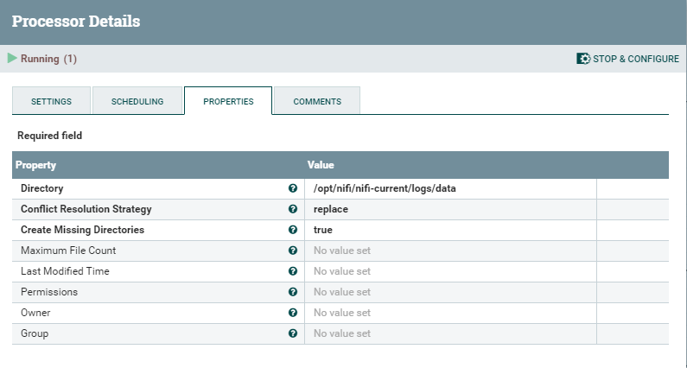
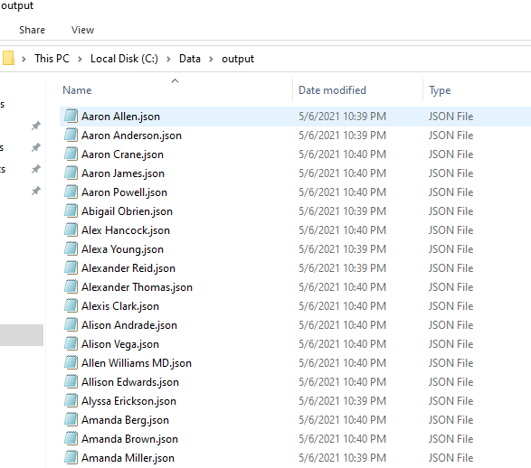
PutFile
The last Processor here is configured to write the generated Flowfiles (now named with .json extension) to the specific directory /opt/nifi/nifi-current/logs/output which will be automatically mounted to c:\data\output

